Slide 1

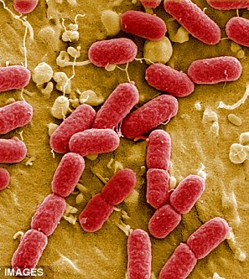
Boolean Network Models in transcriptional regulation and metabolic pathways
Alissa, Aleisha, Aaron

Slide 2
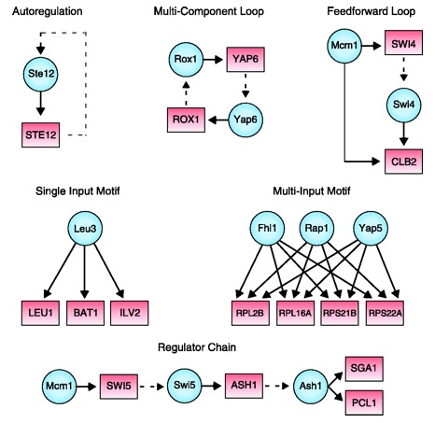
Biological Boolean Network Models:
A directed network graph where each node represents a gene, gene product, or input compound which can be either ‘on’ (1) or ‘off’ (0).
The ‘on’ or ‘off’ state is determined by Boolean functions which use ‘on’/’off’ states of nodes pointing to or inhibiting the node.
Variety of update schemes, methods: truth tables, stochastic models, threshold functions, etc.

Slide 3

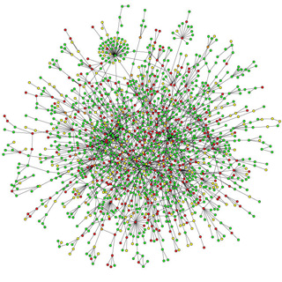
Applications
Cancer research:
Signaling network research:
In silico models of potential knock out effects:
Help run simulations to determine new investigatory pathways

Slide 4
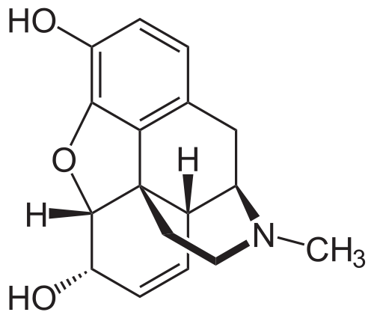
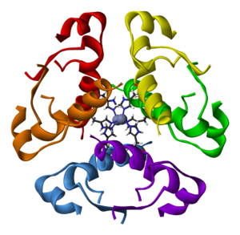
Genetically Modified E. coli:
Medical Modifications
Creation of insulin
Creation of opioids
Creation of vaccines

Slide 5

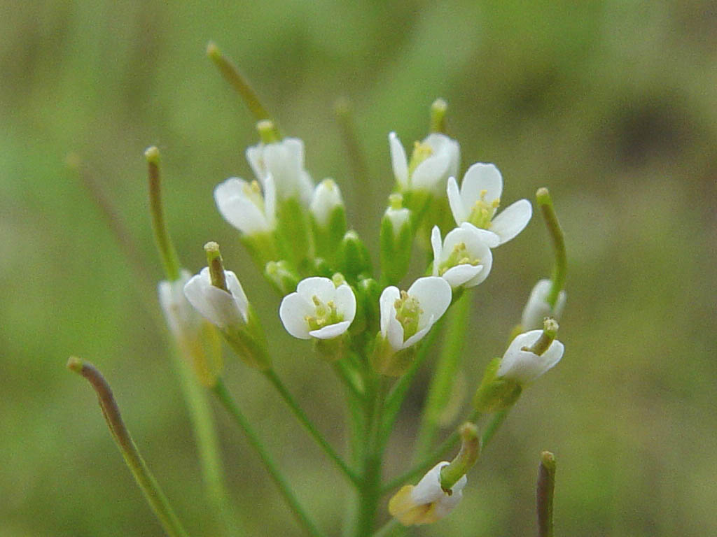
Our pathway: E. coli transgene opiate synthesis
Discovered by Bioengineers at Kyoto University:
Performed modifications to produce opioid precursors.
Enzymes from Opium poppies and genes from other Bacteria Spliced into E. coli:
Coptis Japonica(Opium poppies) – Enzymes added from this plant.
Arabidopsis(Opium poppies) – Enzymes added from this plant.

Slide 6
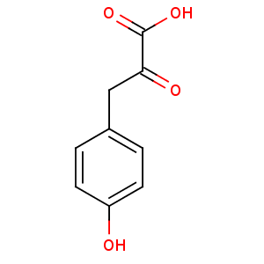
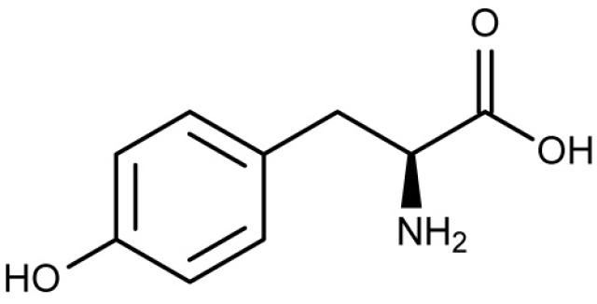
Engineered E. Coli Hydracodone production pathway:
Nodes: 14 Intermediates present in the pathway
Edges: + edges only, as it is assumed that the intermediates will all proceed down the pathway. Edges connect one node to the next in the reaction pathway.
L-tyrosine ----------------------------------→ 4-hydroxyphenyl-pyuruvate

Slide 7
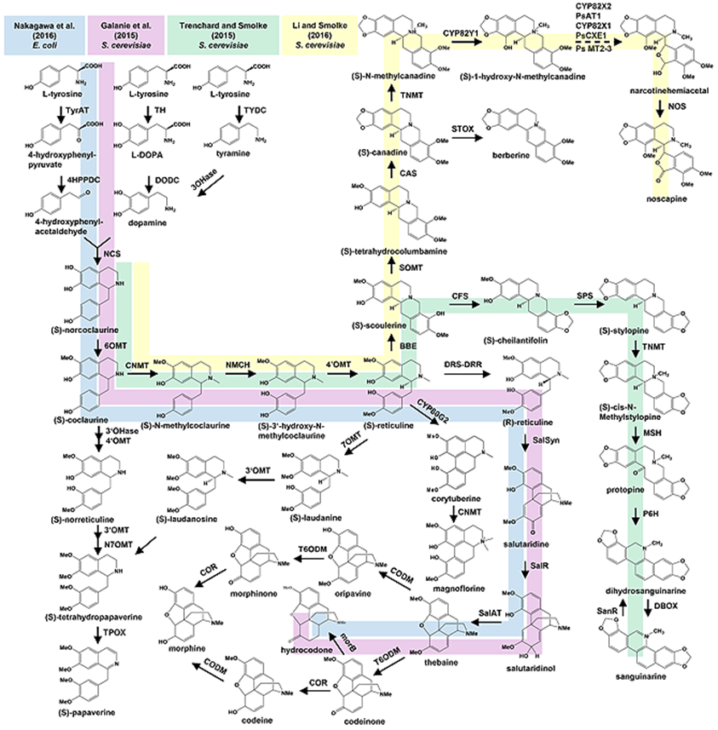

Slide 8
Our program:
A simplistic Boolean network modeler, able to fulfill the following goals:
Generate Boolean Network graphs
Allow for 1 or 0 state models of a given pathway (in our case, a metabolic pathway) by the user entering nodes, edges, and clarifying any Boolean algebraic issues to the program as it generates truth tables
Run a simulation given a starting vector of node states using simultaneous update scheme and Boolean Functions
Show simulation results in graph form
Allow for file I/O with the models to allow the same network model to be pulled up and re-ran later without complete data re-entry
Allow for ‘overpowered’ nodes to simulate more complex network interactions

Slide 9
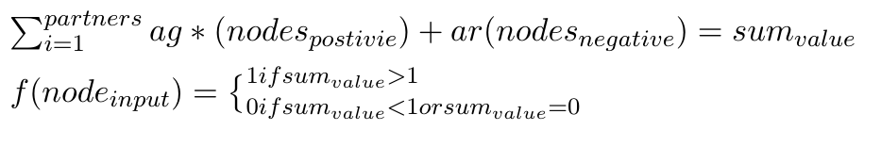
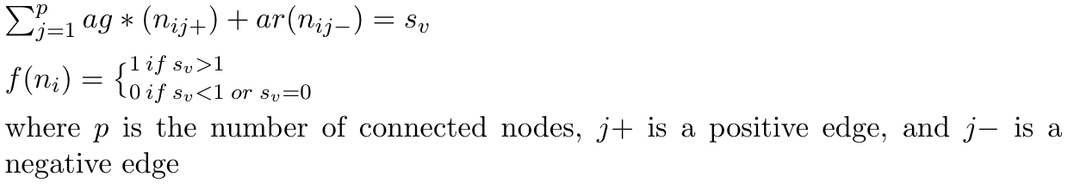
Boolean functions used:

Slide 10
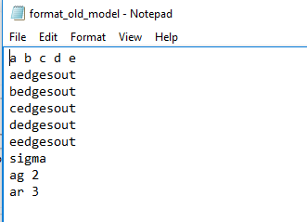
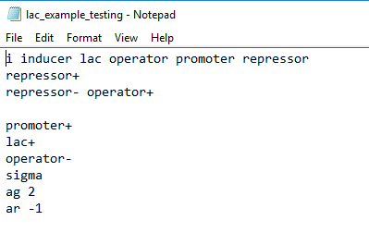
Example Text file:

Slide 11
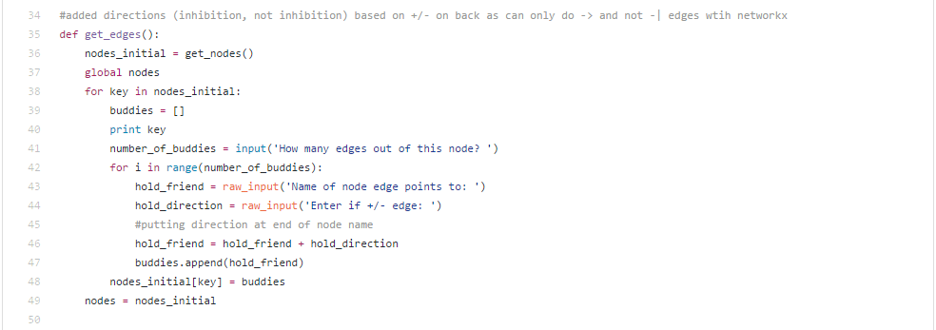
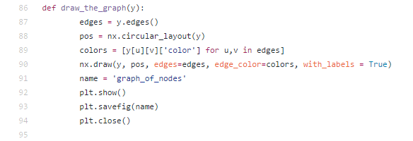
Python code
Libraries we used:
MatPlotLib
NetworkX
Examples from our code:

Slide 12

Running a simulation for A small network

Slide 13
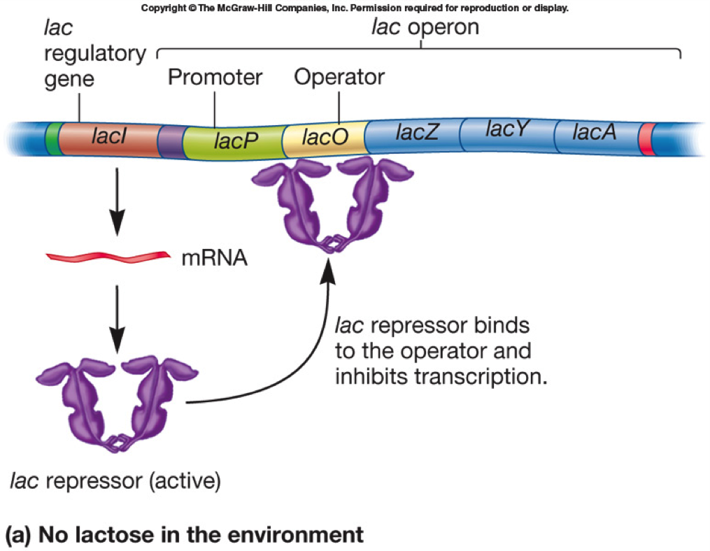
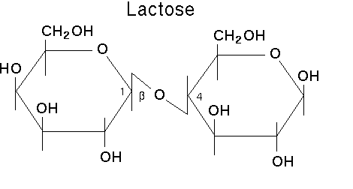
Model of Lac operon:

Slide 14
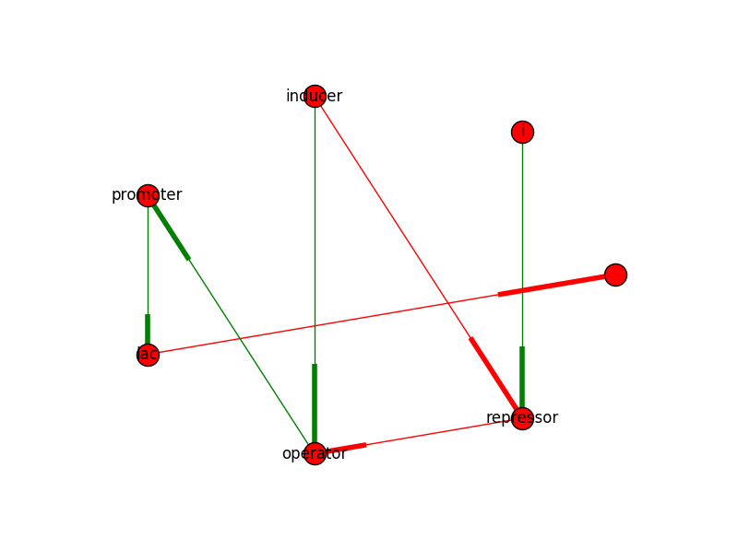
Lac Operon network:

Slide 15
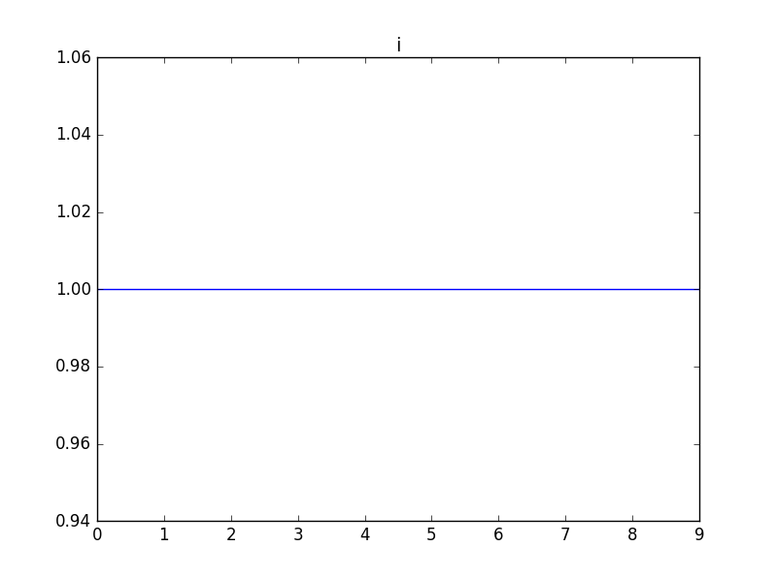
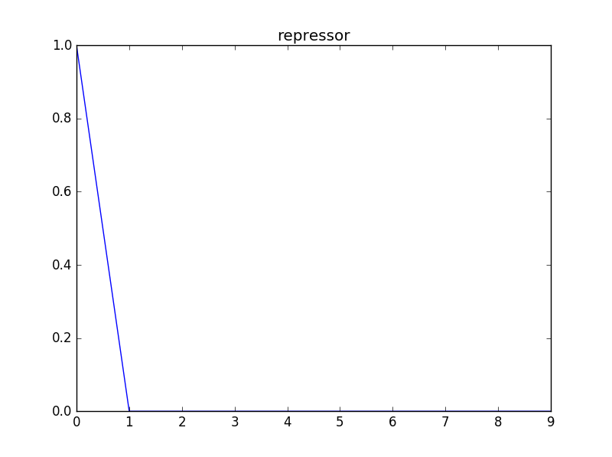
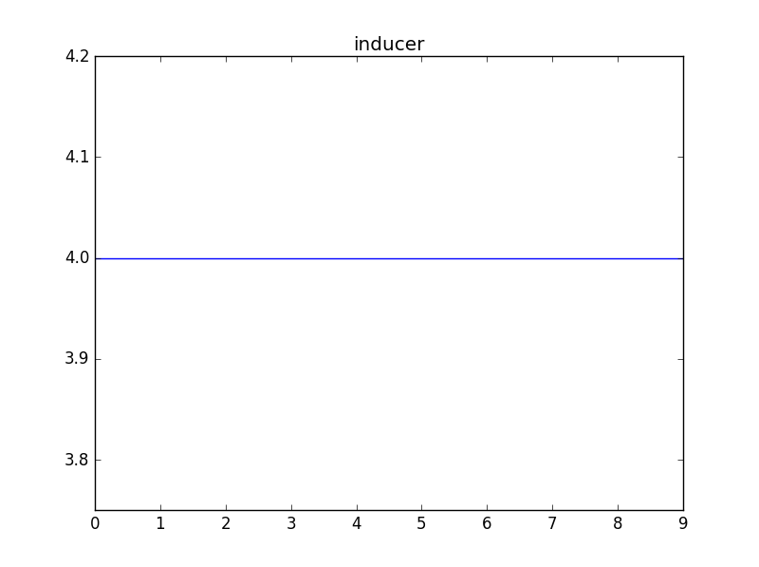
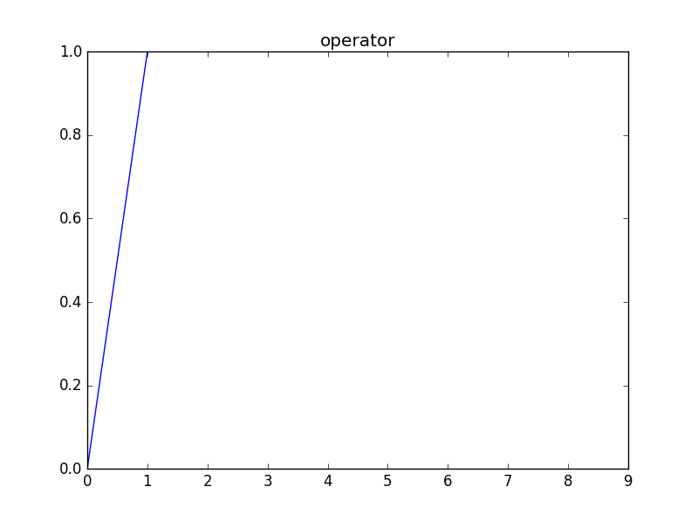
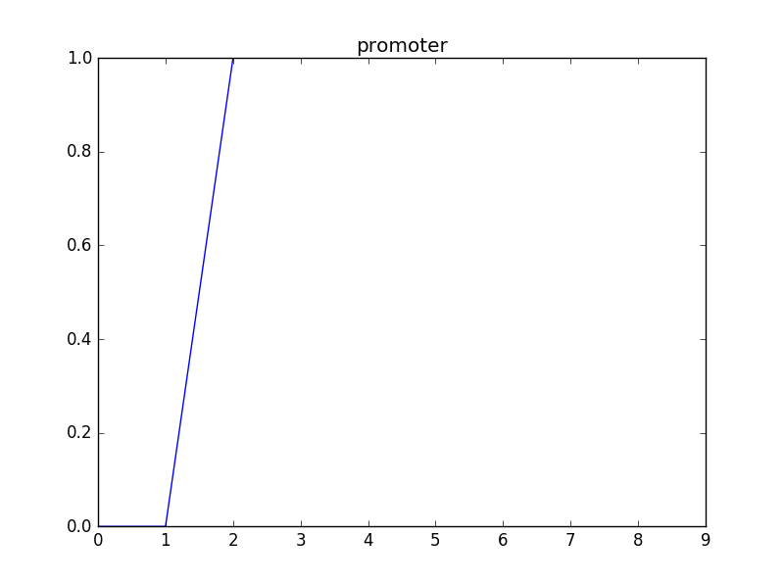
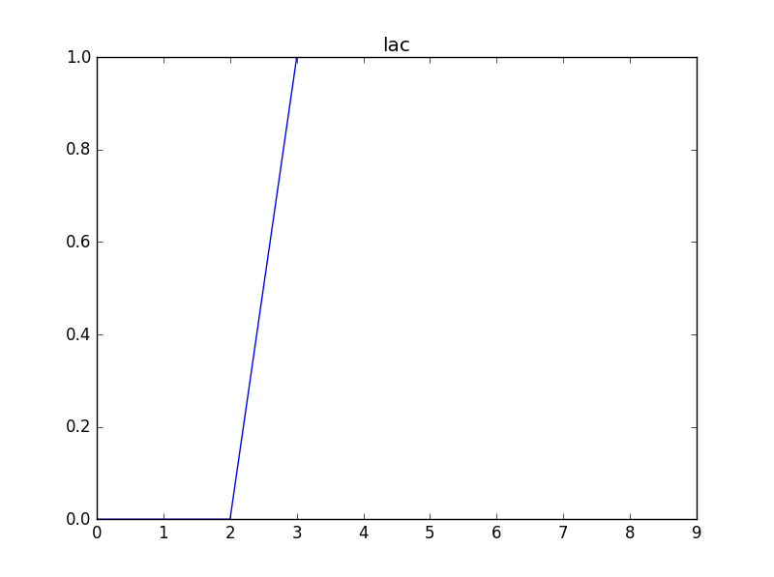
Model results for N=10 generations

Slide 16
modified E. Coli Model

Slide 17
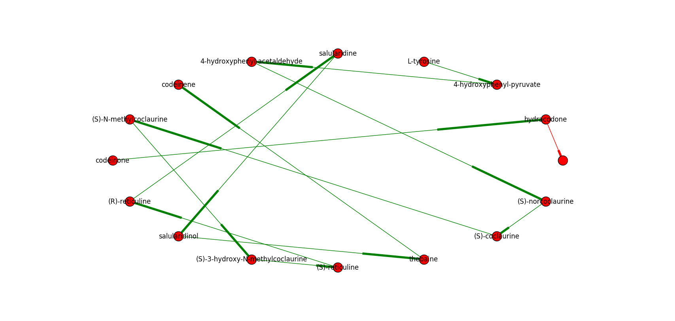
Entering our network:

Slide 18
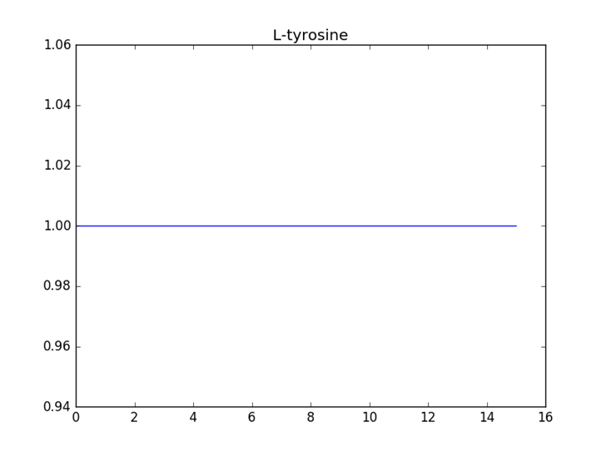
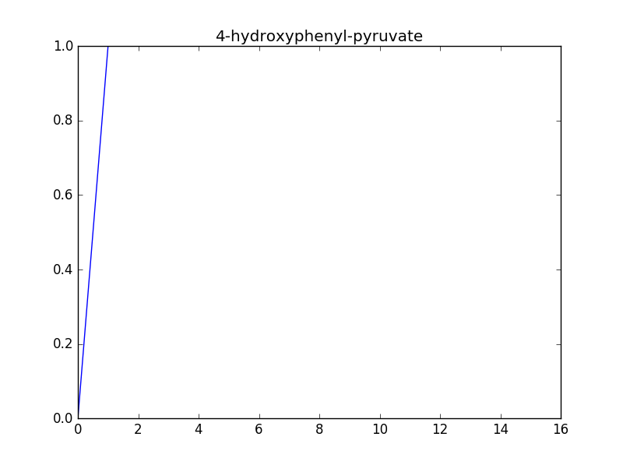

Slide 19
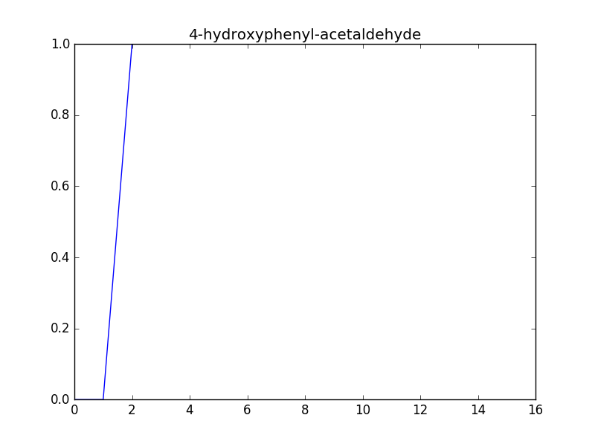
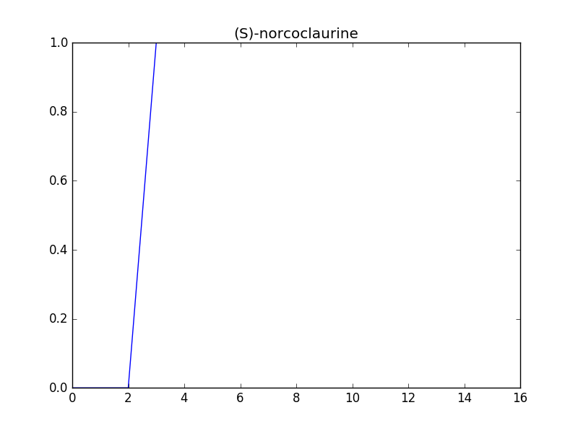

Slide 20
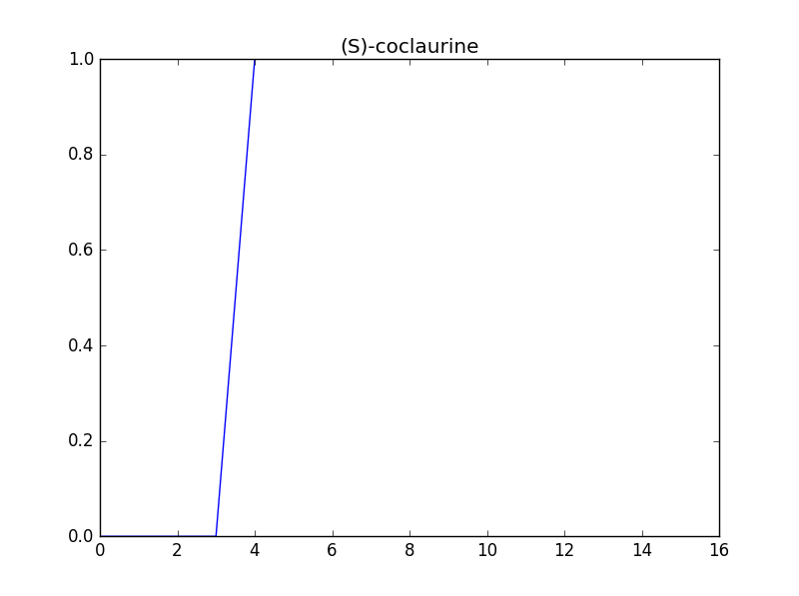
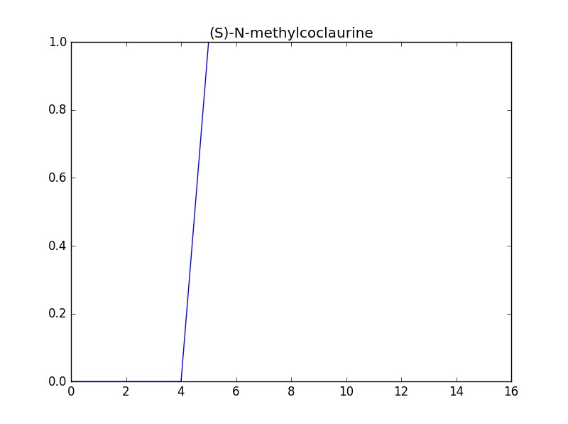

Slide 21
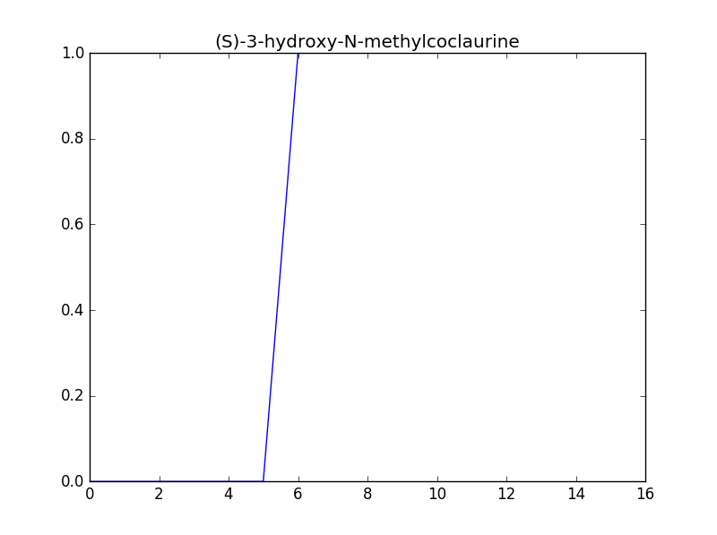
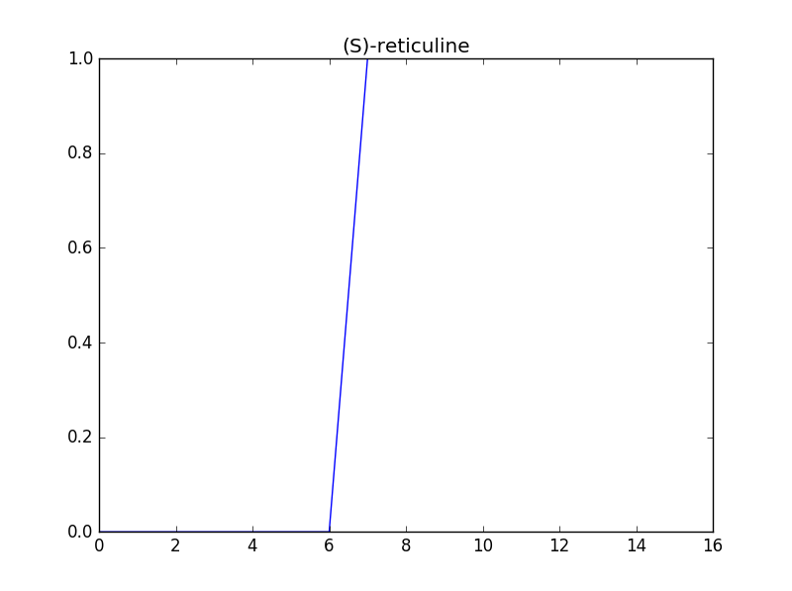

Slide 22
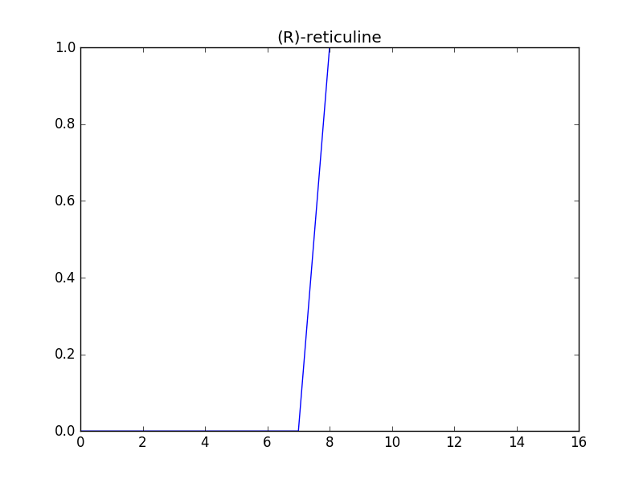
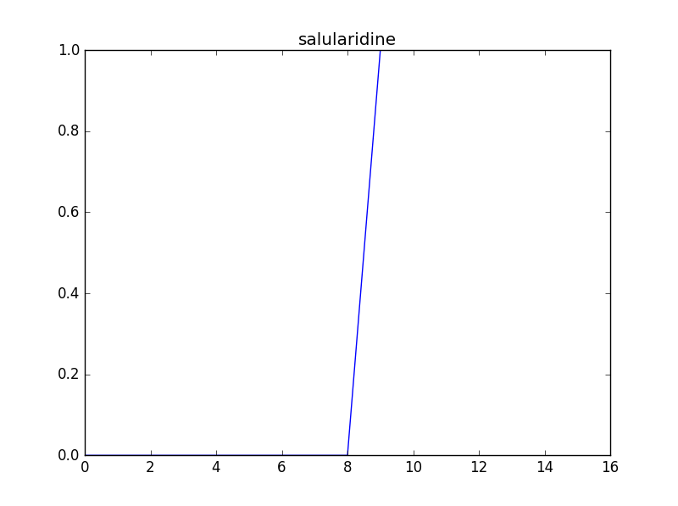

Slide 23
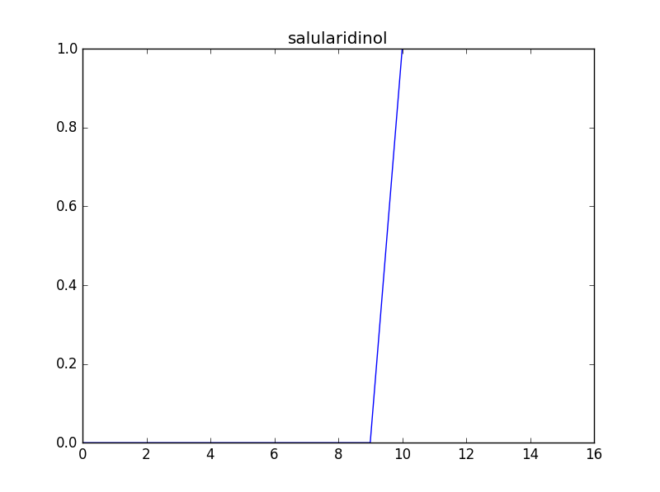
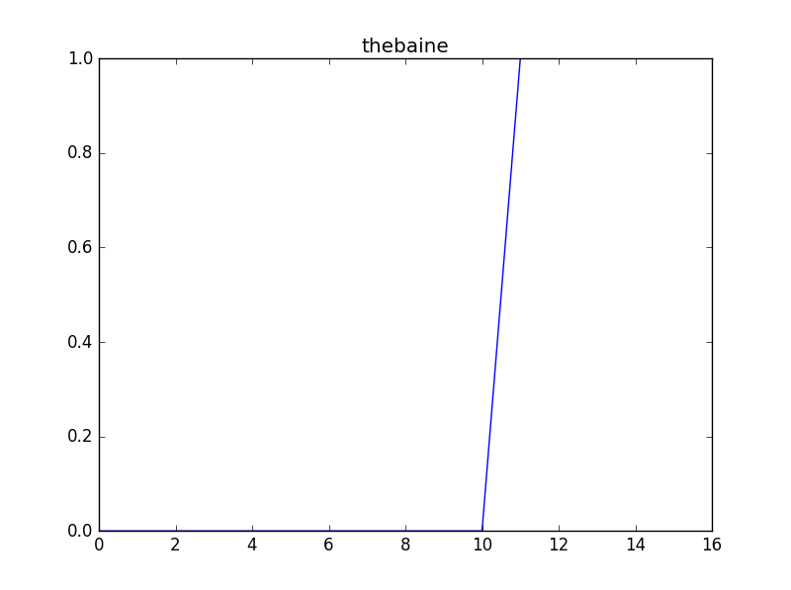

Slide 24
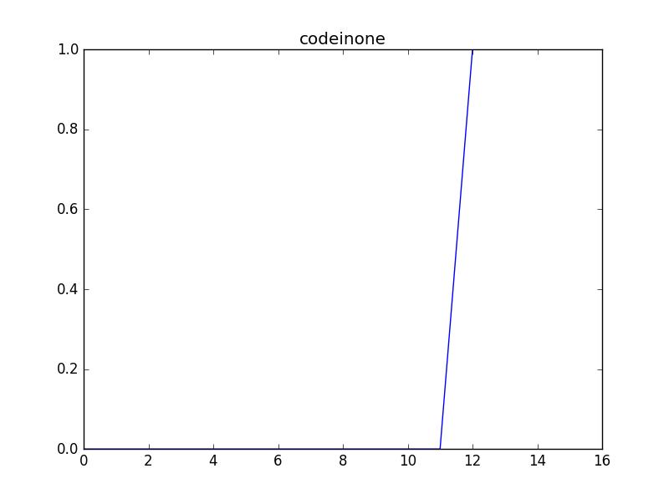
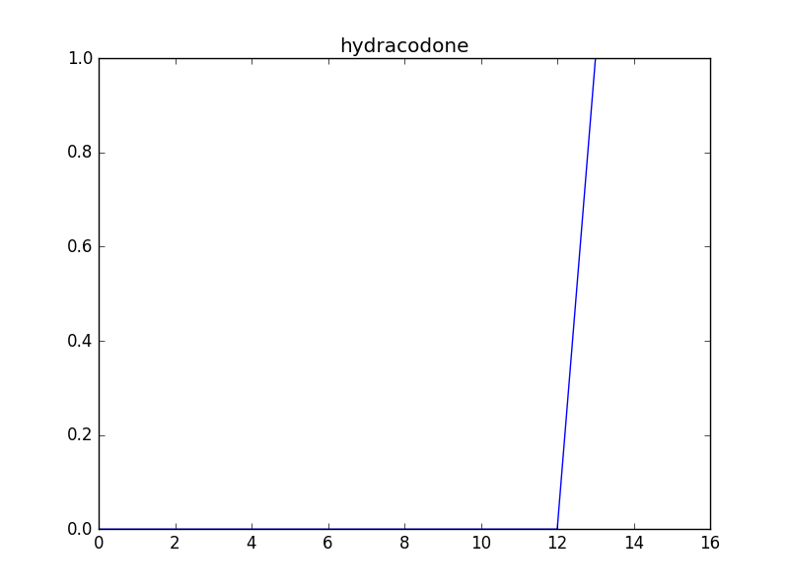

Slide 25
Possible Improvements:
Add in more E. coli metabolic pathways which use common chemical intermediates to make the model more realistic
For example, integrate the model network into already developed E. coli networks which are available in online databases
Allow for asynchronous updating, updating one node slower/faster than others
Allow for mid-model node deletion to model a mutation/defective enzyme
Create own graph generator functions, which can handle self-directed edge visualization in graphs

Slide 26
Sources:
http://www.kyoto-u.ac.jp/en/research/research_results/2015/160205_1.html
http://onlinelibrary.wiley.com/doi/10.1002/biot.201600145/full

